Slide 1
GESTURE CONTROLLED ROBOT

Slide 2
PROJEECTION’19
PROJECT GROUP 4
SHUVAM MITRA
ANIKET DAS
ANIRBAN BASAK
RUDRA BOSE

Slide 3
CONTENTS…
What is a GESTURE CONTROLED BOT?
Components used
Transmitter Circuit Diagram
Receiver Circuit Diagram
Working System of the Bot
Application Field of the Bot

Slide 4
GESTURE RECOGNITION ROBOT
An advance way of controlling wireless bot with hand gestures.
A user friendly way to control wireless gadgets and also an innovative way to control robotic appliances.

Slide 5
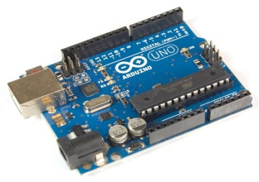
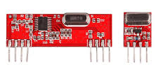
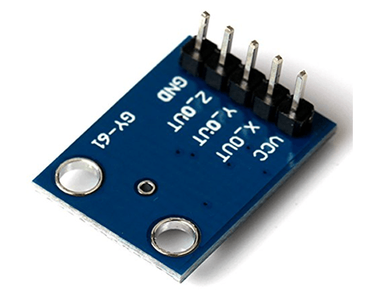
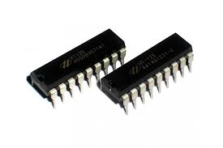
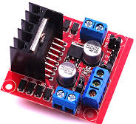
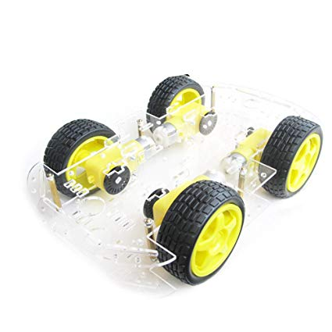
COMPONENTS USED
Arduino UNO/NANO
RF434 MHz Module
ADXL335 (Accelerometer)
HT12E\HT12D Module
L298N Motor Driver
Bot chassis and Wheels,
9V Battery, Jumper Wire etc

Slide 6
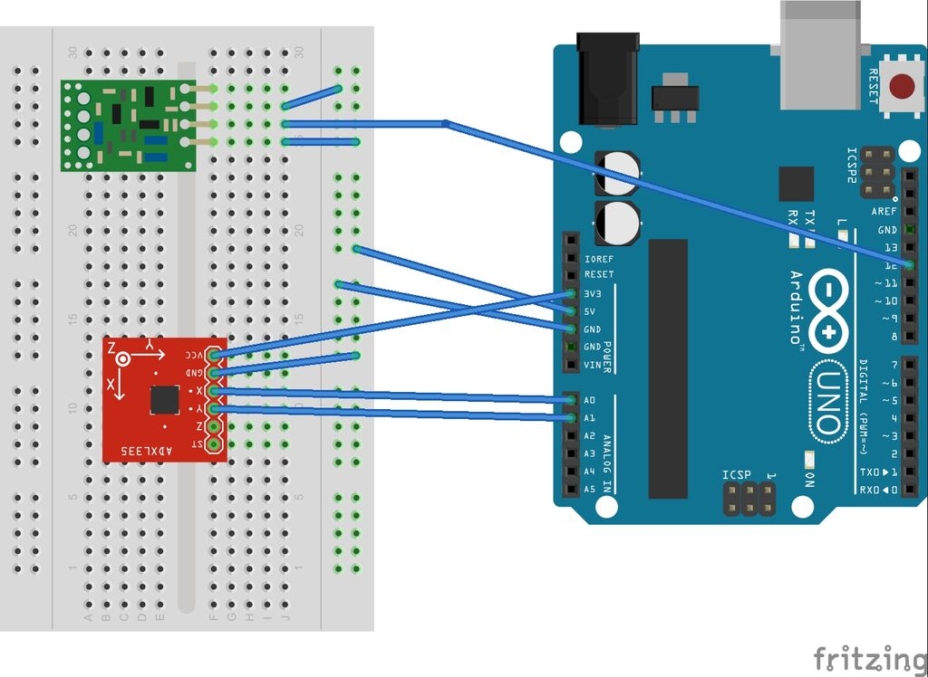
TRANSMITTER CIRCUIT DIAGRAM

Slide 7
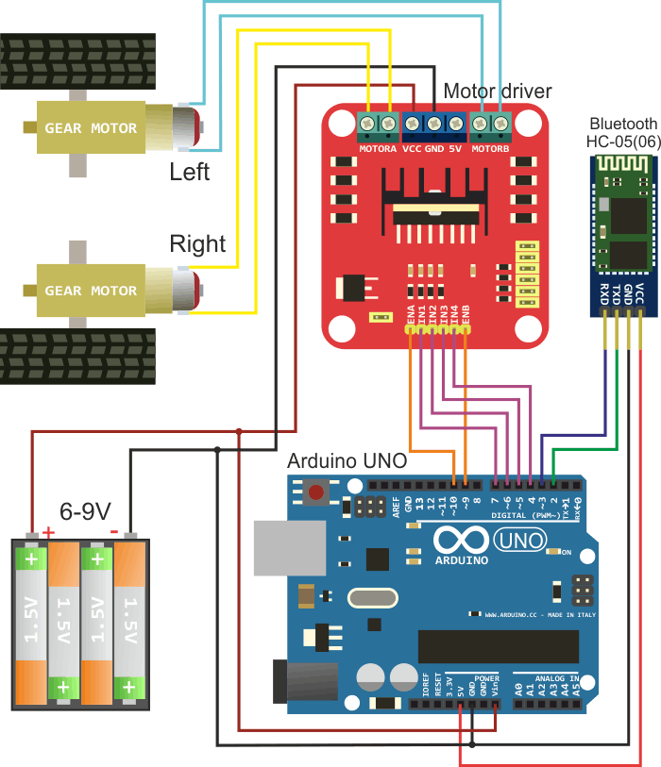
RECIEVER CIRCUIT DIAGRAM

Slide 8
WORKING OF THE BOT
A gesture controlled robot using an accelerometer is one kind of robot which can be operated by the movement of hand by placing an accelerometer on it. This project is divided into two parts transmitter device and receiver device. Where a gesture device works as a transmitter device and a robot works as a receiver device. When a transmitting device (accelerometer) is placed on the hand, then it will send signals to the robot for the required operation.
Accelerometer based gesture controlled robot moves according to the movement of hand as we place the accelerometer on your hand. When we tilt hand with an accelerometer in front of the robot, then the robot starts moving forward until the next movement is given. When we tilt hand in backward direction, then the robot changes its direction and state. Then it starts moving in backward direction until the next signal is given. When we tilt hand on left side, then the robot moves into left side until the next signal is given.In the same way, when we tilt hand in right side, then the robot moves right side.

Slide 9
APPLICATION FIELD OF THE BOT
The application of accelerometer based gesture controlled robot
These robots are used in military applications to operate robots
These robots are used in medical applications for the purpose of surgery
These robotics are used in the construction field
These robotics are used in industries to control trolley and lift.

